Slide 1
Health Protection Surveillance Centre
Surveillance of outbreaks of infectious disease in Ireland:
Q2 2019 provisional data
October, 2019

Slide 2
Provisional data, Q2 2019

Slide 3
Key Points – Q2 2019

Slide 4
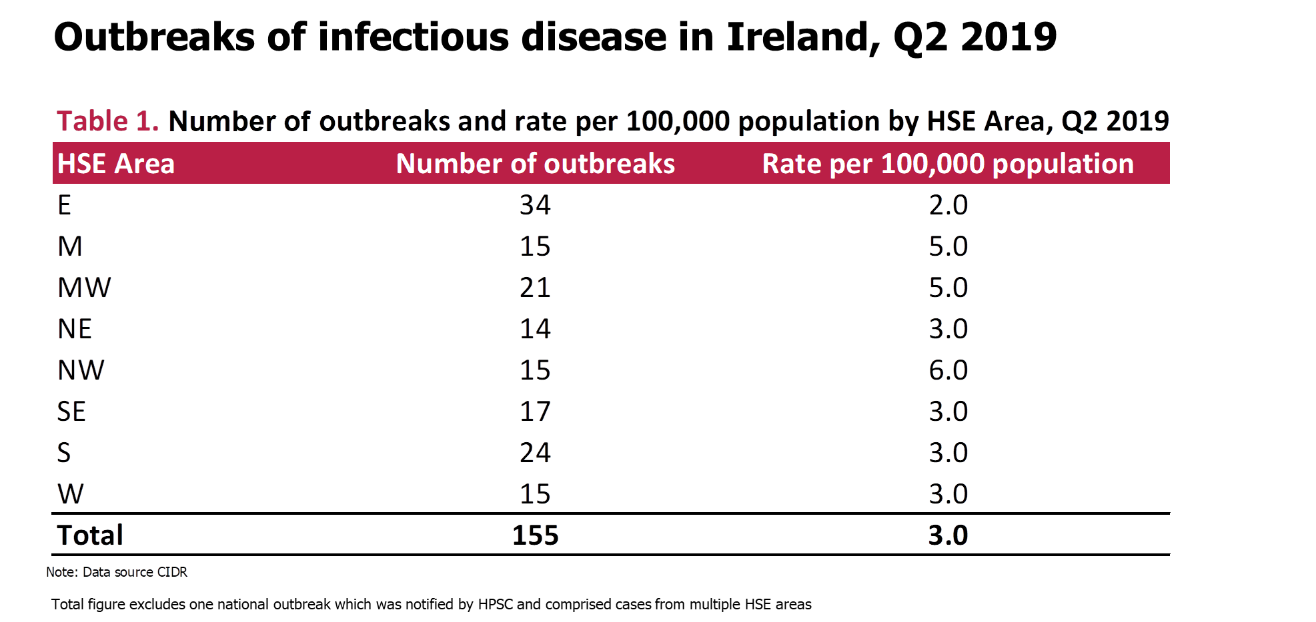

Slide 7
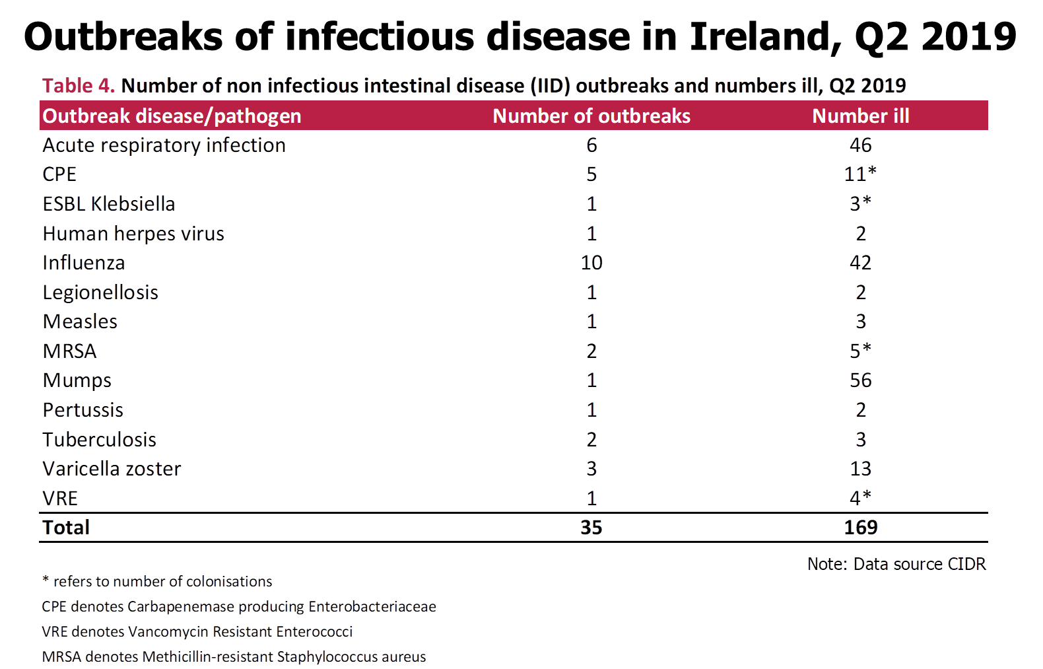

Slide 8
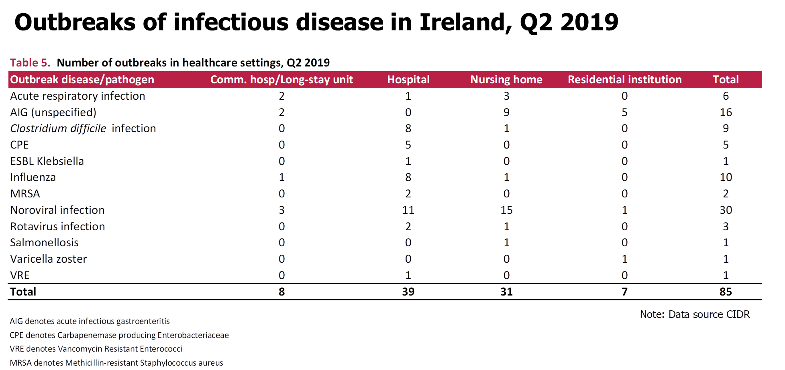

Slide 9
Further Information
Further information on outbreaks can be found at
https://www.hpsc.ie/a-z/outbreaks/

